Slide 1
Identifying Malignant Mammograms
Using Transfer Learning and CNNs

Slide 2

Impact
Second most common cancer for U.S. women
Second most cancer related mortalities
Fifth leading cause of death worldwide
1 in 8 women will develop it during their lifetime

Slide 3

Early detection
Major reason deaths are down 43% since 2020
Five year survival rates:
99% - Localized SEER Stage
86% - Regional SEER Stage
31% - Distant SEER Stage
Early detection = Less radical treatments
Regular mammograms are key
Can detect abnormalities well before they can be felt
Skillful interpretation is critical

Slide 4
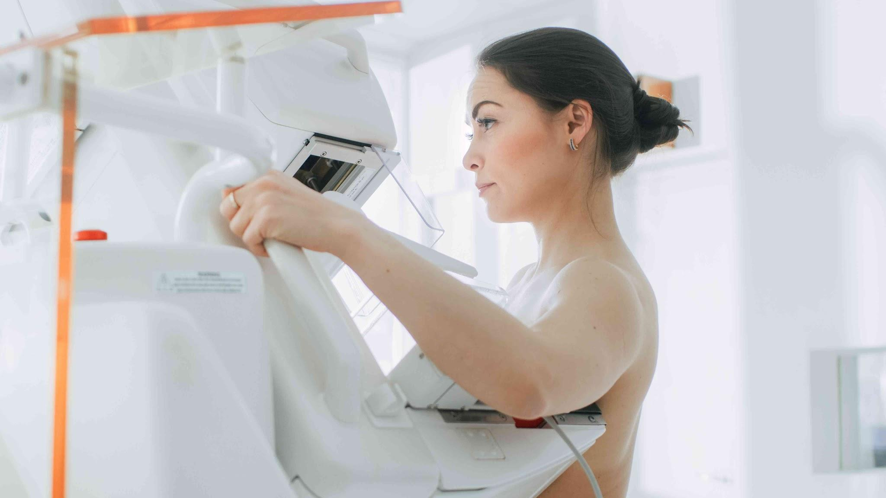
Problem Statement
Mammograms aren’t perfect
Require skilled mammographers
1 in 8 cancers go undetected
High false positive rates
Costly (Time and Money)
Leads to unnecessary anxiety

Slide 5

Project Goal
Use transfer learning and a CNNs to identify malignant abnormalities in mammogram images
Use updated and standardized Digital Database for Screening Mammography dataset (CBIS-DDSM)
Predict malignant abnormalities with > 87.5% sensitivity while having a reasonable specificity

Slide 6
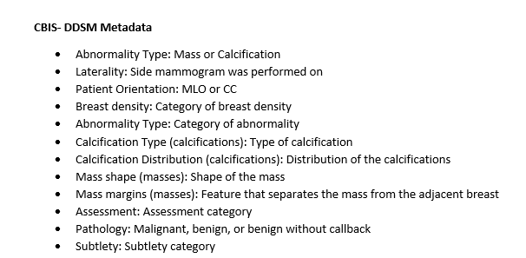
Dataset
Digital Database for Screening Mammography (DDSM)
2,857 full mammogram images
3,566 cropped mammogram images
3,463 region of interest (ROI) mask files
Normal, benign, and malignant cases for masses and calcifications with verified pathology information from four hospitals
Massachusetts General Hospital
Wake Forest University School of Medicine
Sacred Heart Hospital
Washington University of St. Louis School of Medicine
Associated metadata files matched between training and testing sets

Slide 7
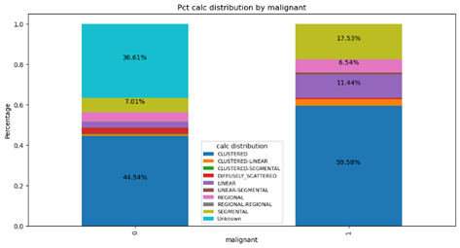
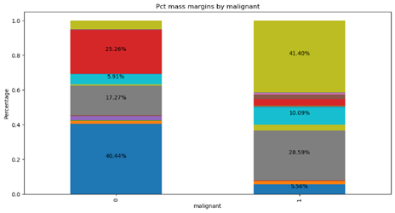
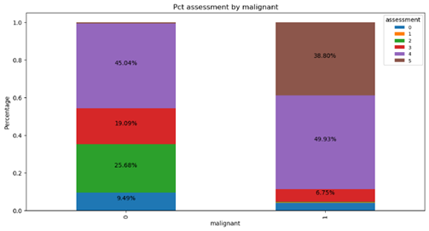
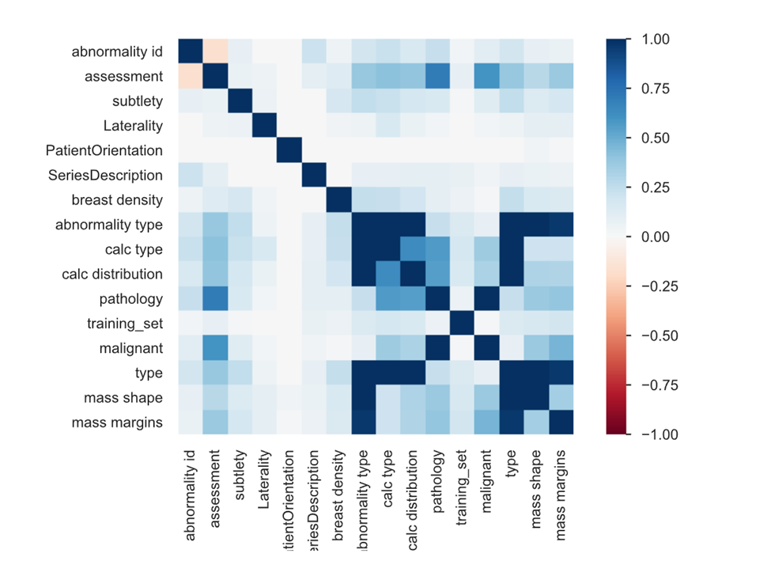
Exploratory Data Analysis
Project focused on classifying images as (1) “Malignant” and (0) “Not Malignant”
Differences in distributions between classes:
Calcification Distribution
Mass Margins
Assessment
Correlations with Malignant:
Calcification Distribution
Calcification Type
Mass Margins
Mass Shape
Assessment

Slide 8
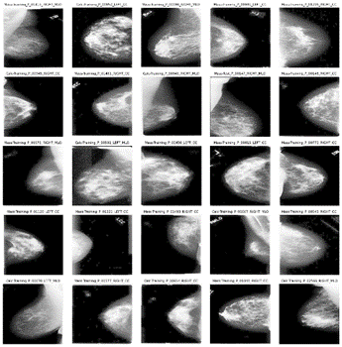
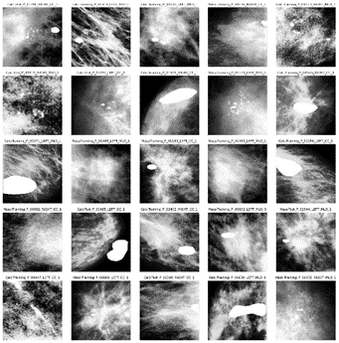
Model Training - Image Preprocessing
Cropped images and ROI Masks
Image Resizing
Height: 224 pixels
Width: 224 pixels
Color Channels: 3
Histogram equalization

Slide 9

Model Training - Training, Validation, and Testing
CBIS-DDSM
Pre-split into training and testing sets (80%, 20%)
Matched on metadata
Validation Set
Created from random sample of testing set
80 / 10 / 10 split

Slide 10

Model Training - Models
Three different pretrained CNNs were evaluated during training on two sets of labels:
DenseNet169 - Malignant
DenseNet169 - Pathology
Xception - Malignant
Xception - Pathology
EfficientNetV2S - Malignant
EfficientNetV2S - Pathology
Imagenet weights were used
Relatively small size models with high accuracy on image classification tasks

Slide 11
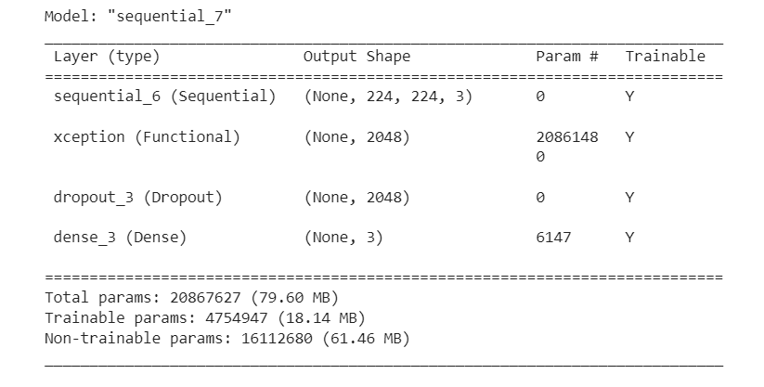
Model Training - Model Specifications
Optimizer: Adam
Loss Function: Categorical Crossentropy
Learning Rate: .001
Batch Size: 32
Epochs: 30 (with early stopping)

Slide 12
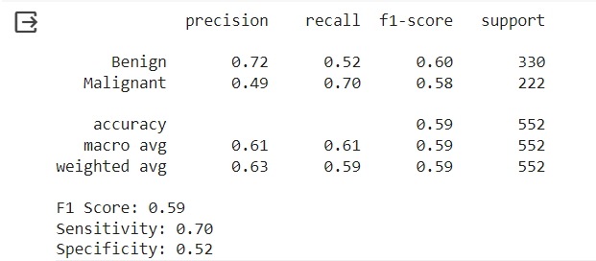
Model Selection
Xception
Malignant labels
Sensitivity = 0.85
Specificity = 0.29
Pathology Labels
Sensitivity = 0.70
Specificity = 0.52
Highest sensitivity on the testing set with specificity higher than Dummy Classifier

Slide 13
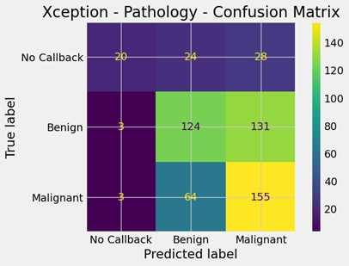
Testing Set - Further Analysis
Most errors confused malignant with benign images (and vice versa)
Very few predictions for No Callback (Normal)
Model seemed to naturally group images into two categories

Slide 14
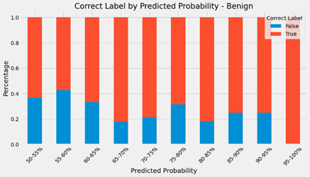
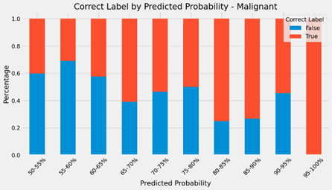
Testing Set - Further Analysis (continued)
Model tended to perform better when it was more confident in a prediction
Effect was noticeable for both malignant and benign predictions
Implications for practical applications

Slide 15

Final Thoughts and Future Research
Model was not able to meet the initial goal of classifying malignant mammograms with > 87.5% specificity
Importance of false positives in final model selection
Ideas for future research / practical applications:
Train model on more images
Use multiple images from same patient to diagnose cases
Use predicted probabilities to reduce number of reviewed mammograms

Slide 16
Thank you.

